Slide 1
Use SARIMAX, LSTM, PROPHET Methods to Forecast Revenues - Technical Ideas & Approaches
Team 6
Yu Luo, Benxi Pang

Slide 2
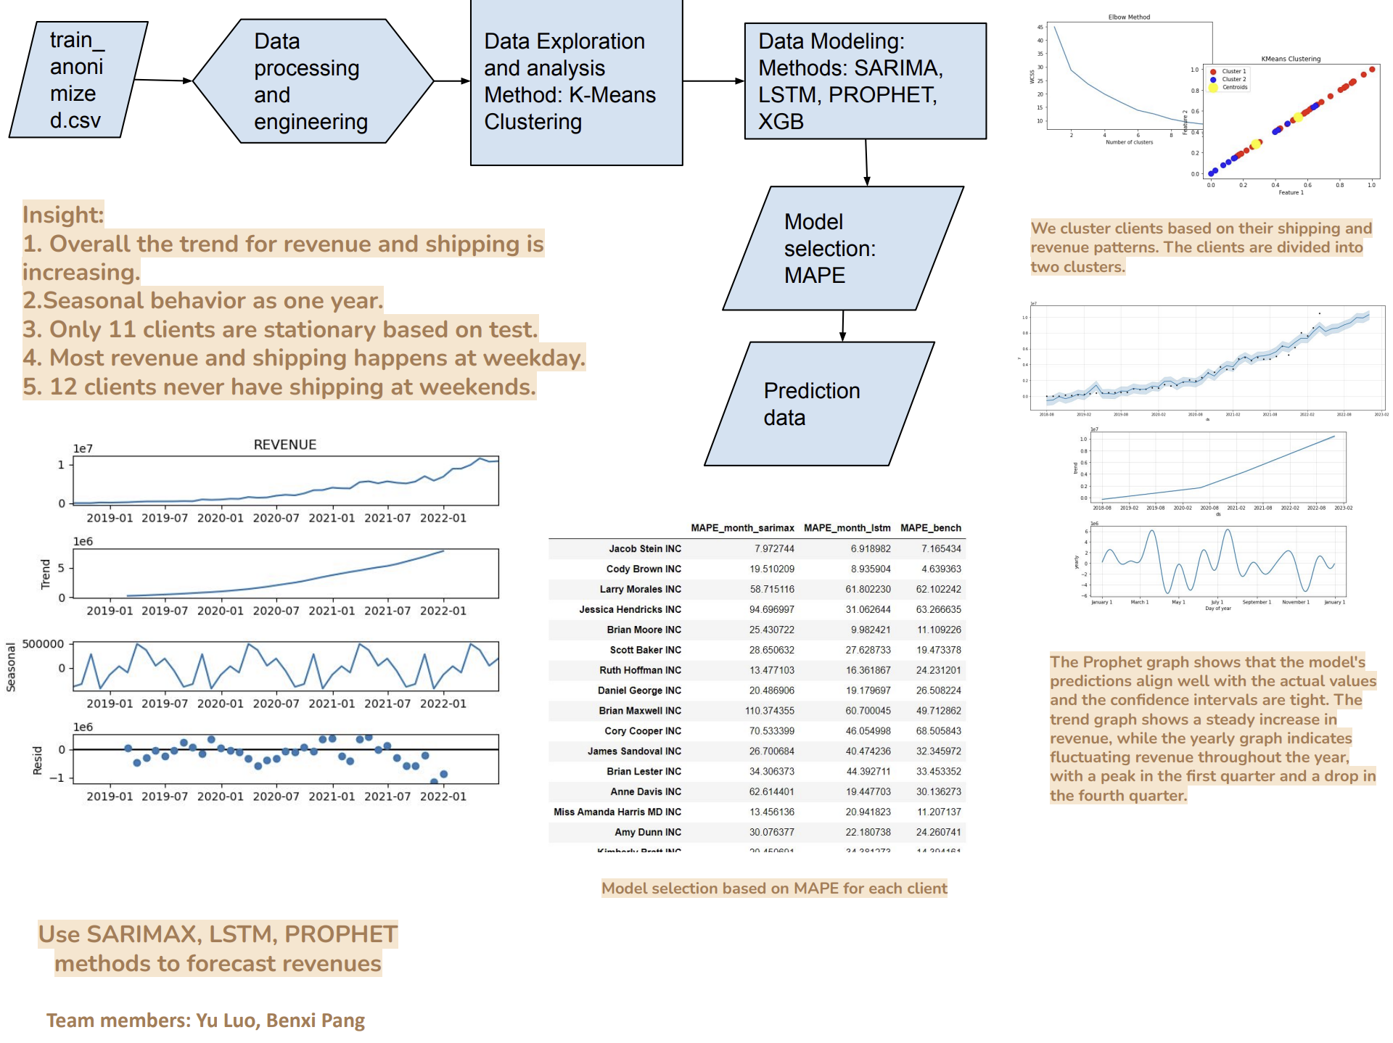
Outline
Data Preprocessing
Modeling and model selection
Forecasting
Clustering Analysis
Business Insights

Slide 3
Problem Statement
XXXXXXX, leader in the Mailing meters space, to better understand their has high scale shipping enterprises who do business with us.
Use the data to forecast 6 months revenue for the clients, and generate insights and recommendations based on the results.
Clients' seasonalities, client segments, and throughput behavior.

Slide 4
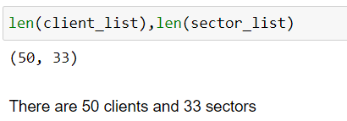
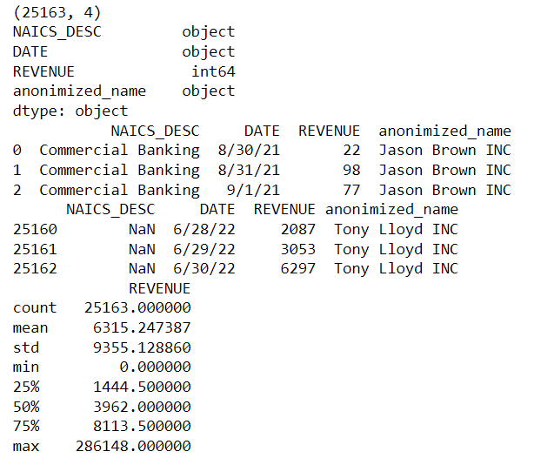
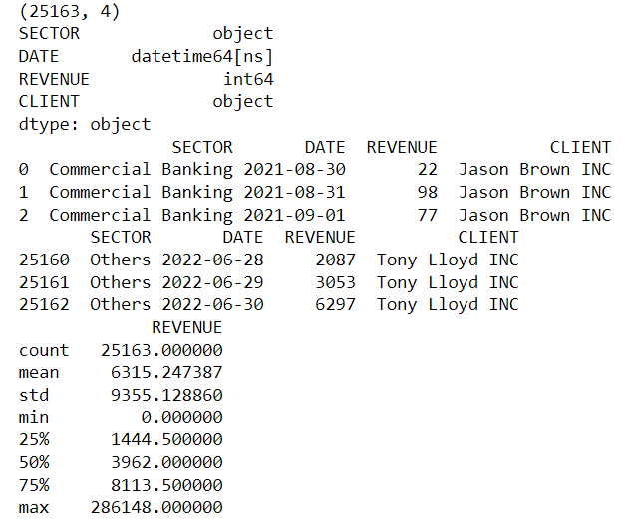
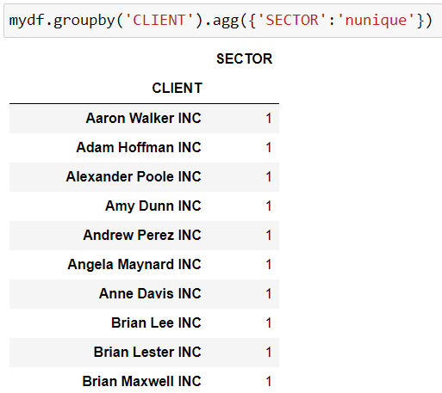
DATA UNDERSTANDING, CLEANING, POTENTIAL DATA ERROR
Variable:
NAICS_DESC
DATE
REVENUE
anomized_name
After rename and fill Nan with Others:
Variable:
SECTOR
DATE(datetime format)
REVENUE
CLIENT
Check if there all the client corresponding to only one unique Sector

Slide 5
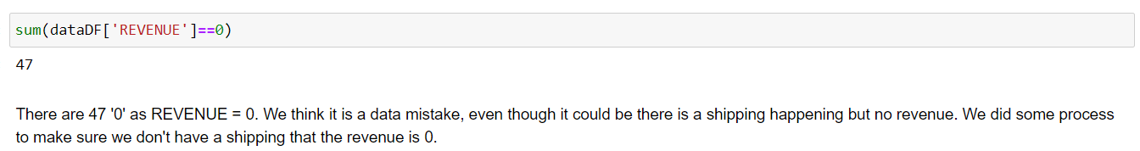
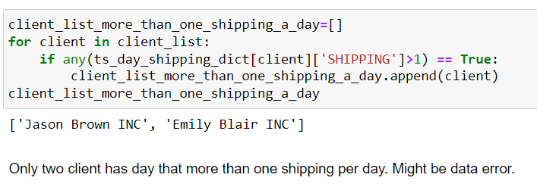
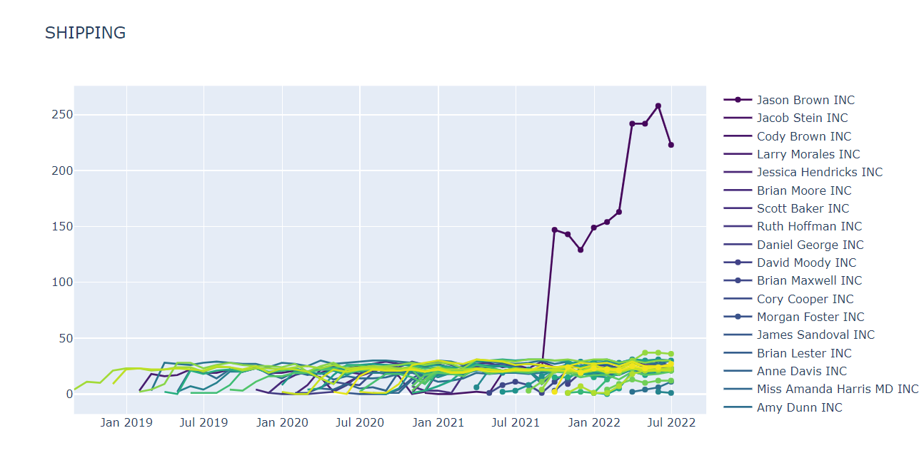
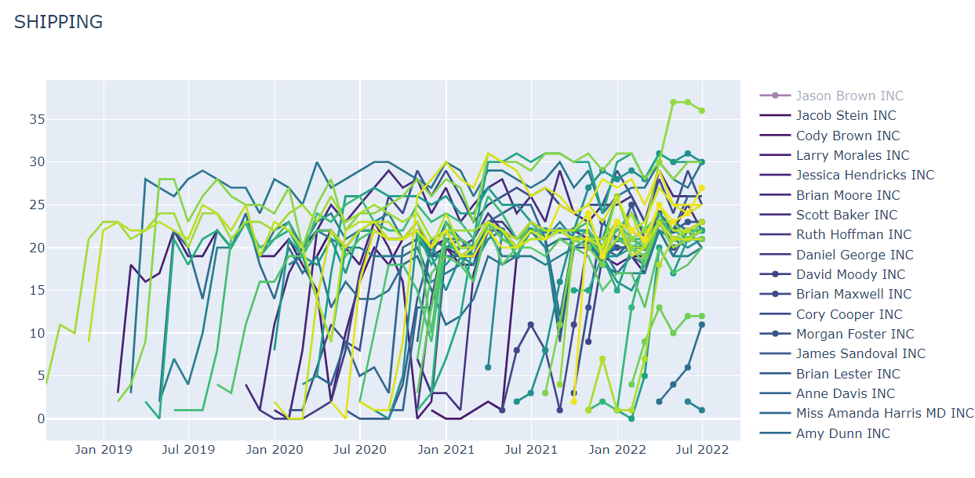
POTENTIAL DATA ERROR

Slide 6
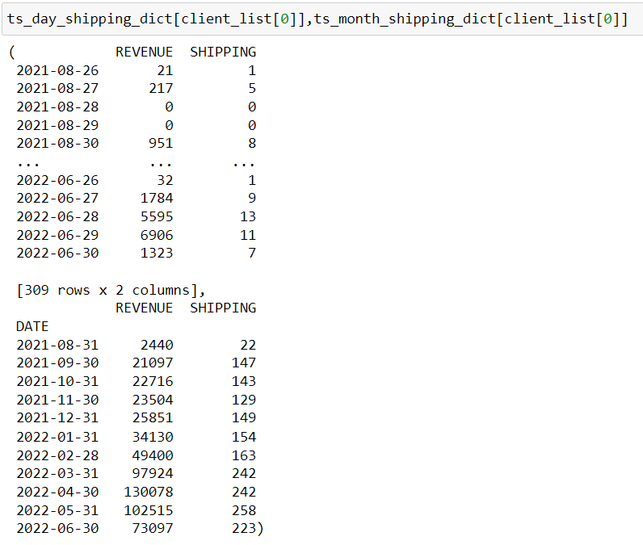
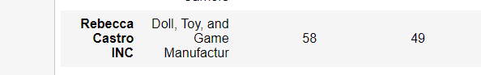
Data preprocessing:
Using Dictionary to store Time series Data for each client
Store two dictionaries contain dataframes that index is date and columns as daily or monthly revenue and shipping. We only count shipping as if corresponding revenue is more than 0. Also we fill 0 as revenue and shipping thru 2022-06-30 if last day is not 2022-06-30.
As ‘Rebecca Castro INC’, we have 58 as how many days between first day of this client to 2022-06-30 and 49 as how many days of the first day of this client to the last day of this client(meaning last day is the day that has non zero shipping value). We see a difference. We believe it is due to data missing as the last 9(58-49) days there should be 0 shipping and 0 revenue for each day.

Slide 7
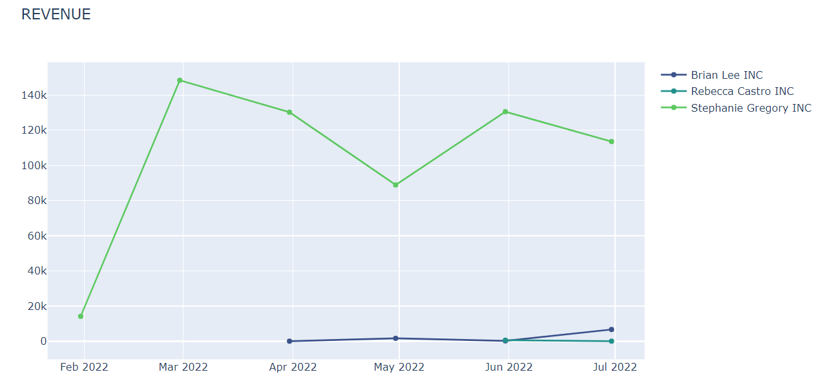
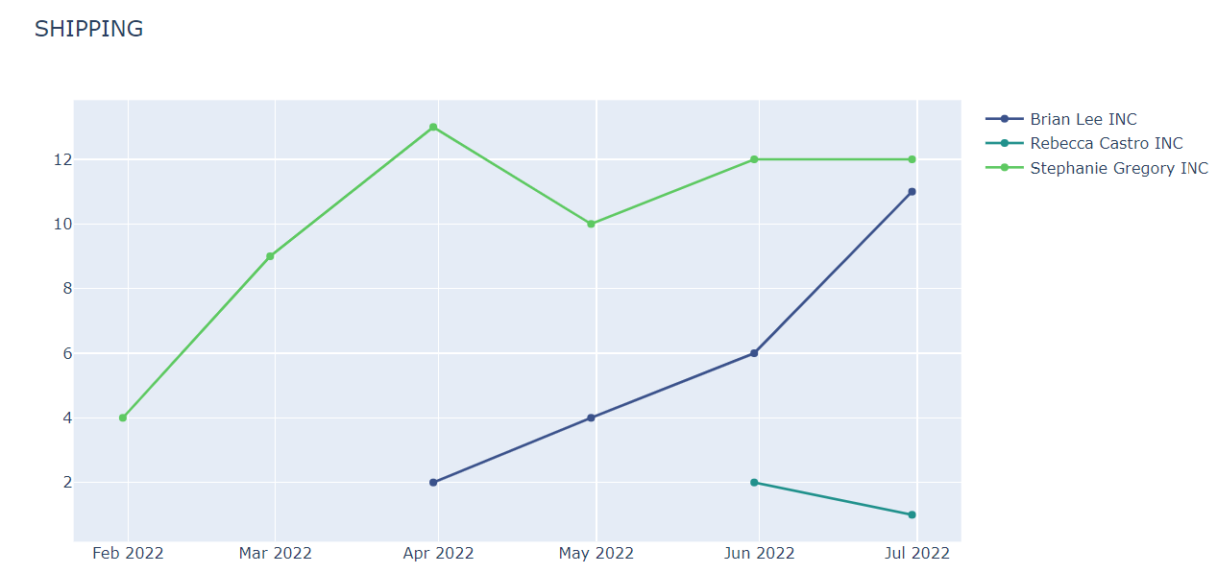
We made three categories for clients using how long they have been doing business with Piteny Bowes. Over 12 months, 6 to 12 months, under 6 months. Below are the monthly plots for revenue and shipping for clients that are under 6 months. We see there are only three clients.

Slide 8
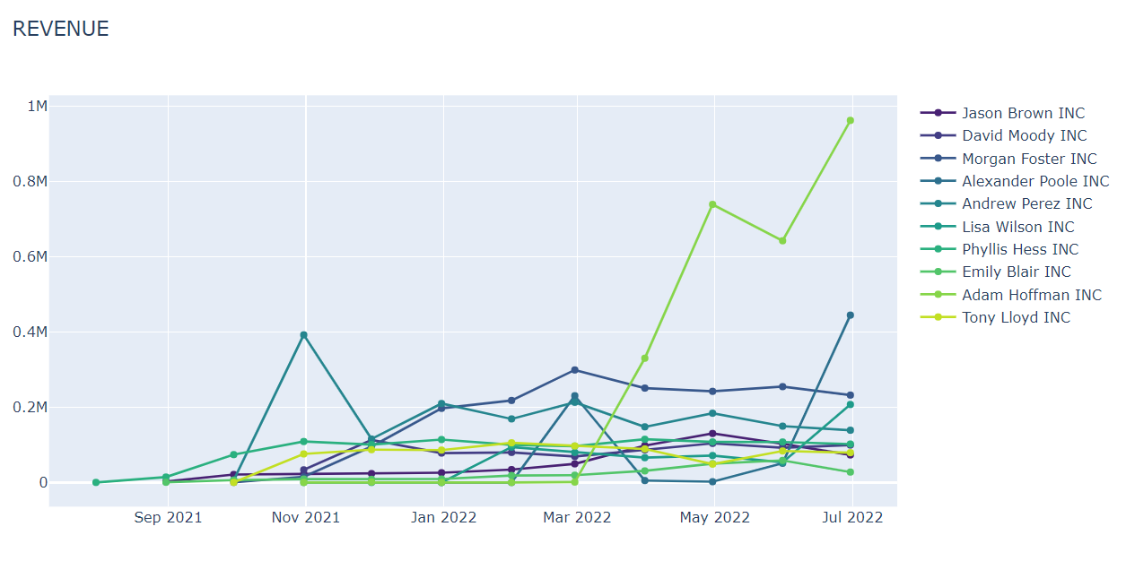
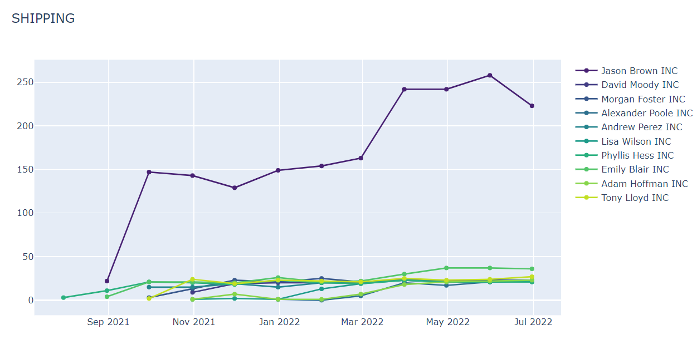
Below are the monthly plots for revenue and shipping for clients that are between 6 months to 12 months. We have 10 clients here. Shipping data for Jason Brown INC looks like there might be an error. We will address it later.

Slide 9
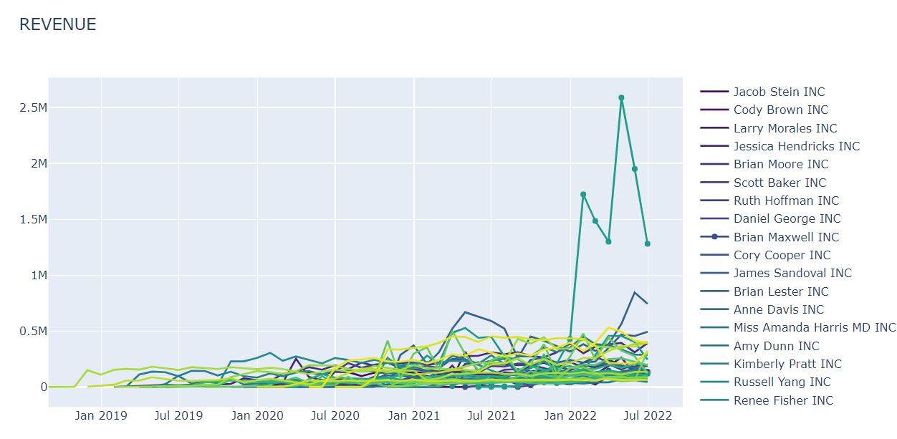
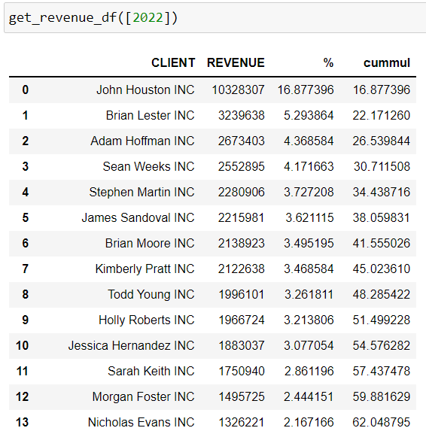
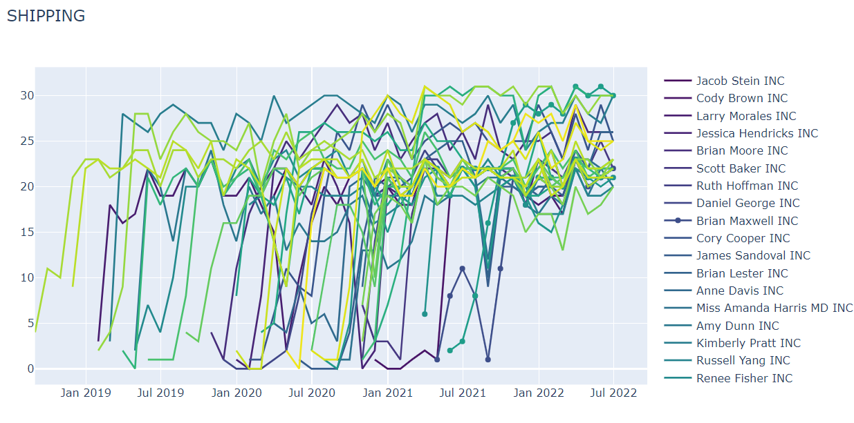
Below are the monthly plots for revenue and shipping for clients that are over 12 months. We notice that there is a client that has much more revenue than others recently. We see that the client is ‘John Houston INC’ taking almost 17% of the total revenue of 2022, while others at most counts for 5%.

Slide 10
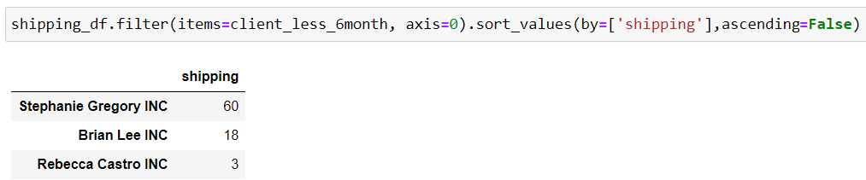
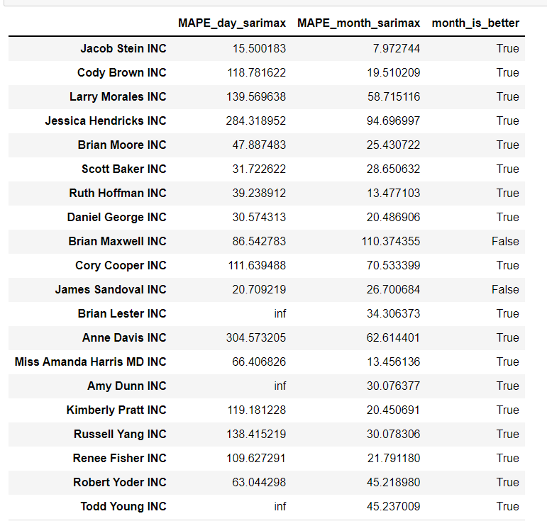
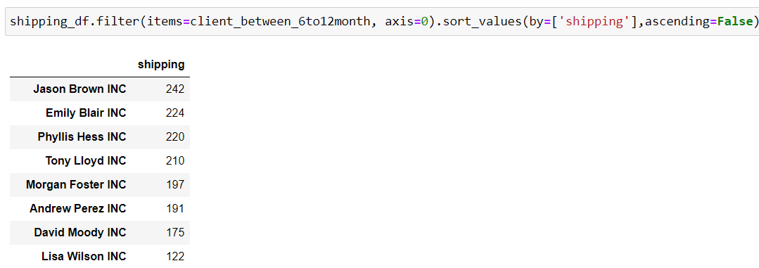
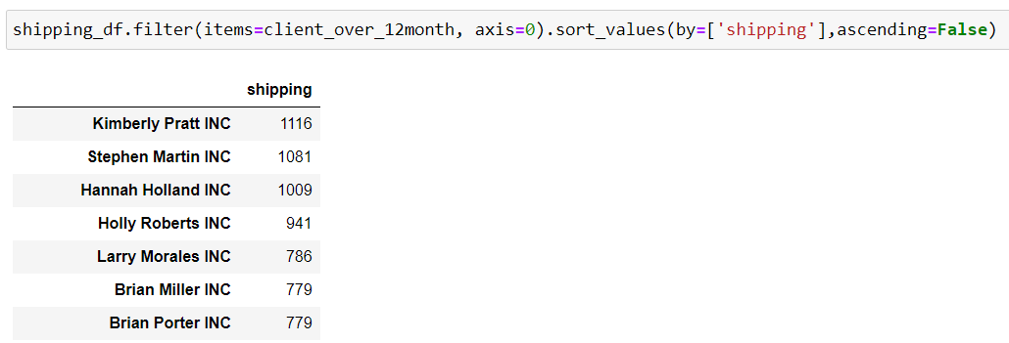
The reason why we have created two dictionaries regarding daily data and monthly data is that we notice that if we only use monthly data for our prediction then we might end up with limited data points. So we think that maybe we should try using daily data for modeling and then aggregate the prediction into monthly data for validation. One problem with this approach is that it will create noisy in our prediction. Unfortunately, the performance of using daily data is constantly worse than using monthly data, either by using SARIMA or LSTM, not to mention that using daily data is much more time consuming. Therefore, we decide to only use monthly data for prediction.

Slide 11
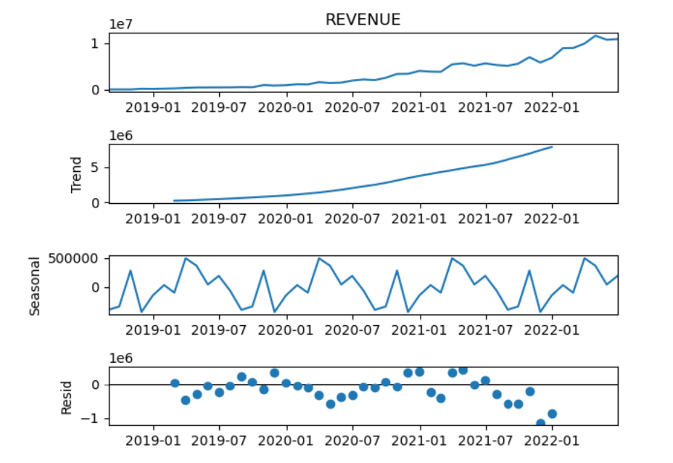
Seasonal decompose of total revenue:
We see that the overall trend is increasing and yearly seasonal behavior.

Slide 12
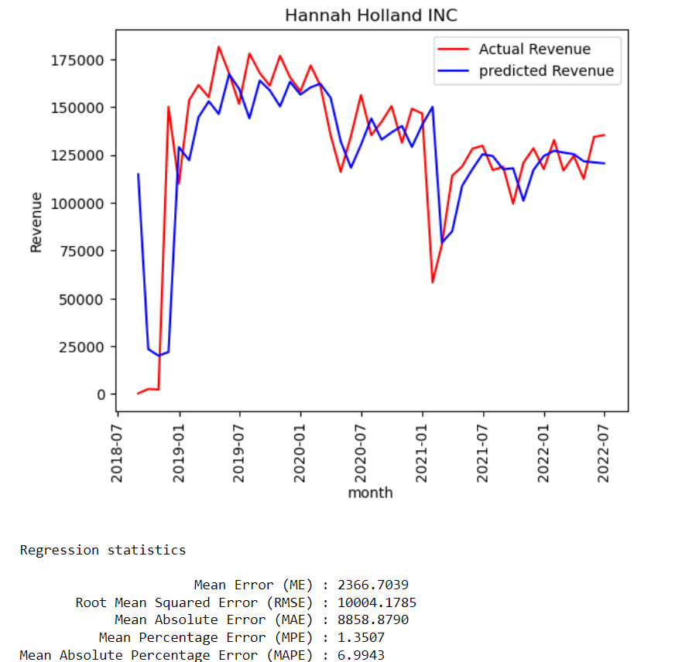
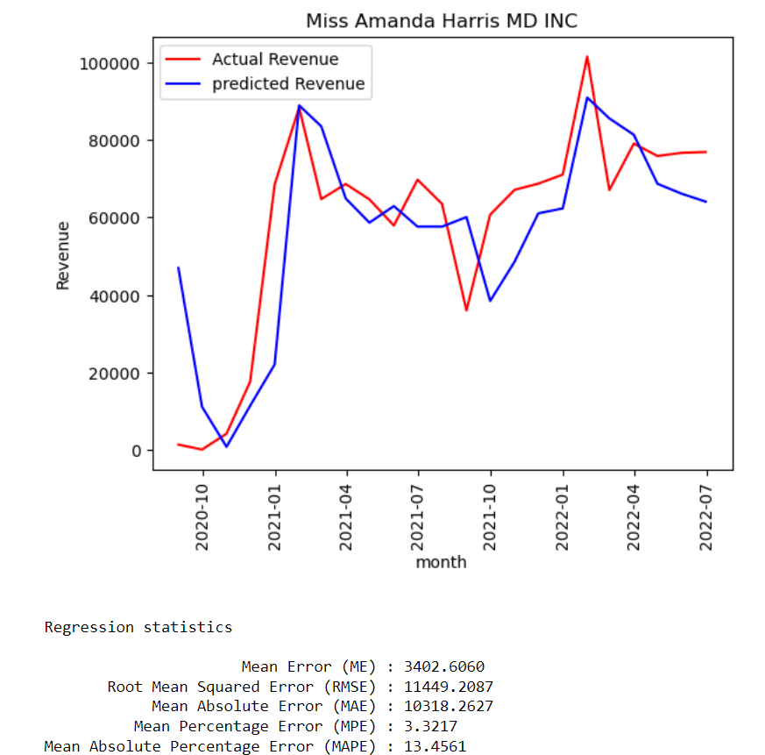
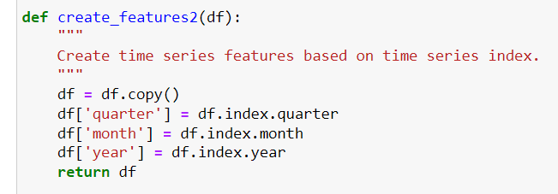
Clients over 12 months(Validation: 6 months)
Benchmark model: naive model(using last month to predict)
SARIMA:
1) We create some feature based on the monthly data for exogenous variables. We drop shipping column as at the time of prediction we do not know the total shipping of the month.
2) We use auto_arima to get the best order and seasonal_order for SARIMAX model. Here we assume the seasonal parameter is 1(yearly).

Slide 13
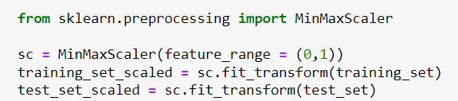
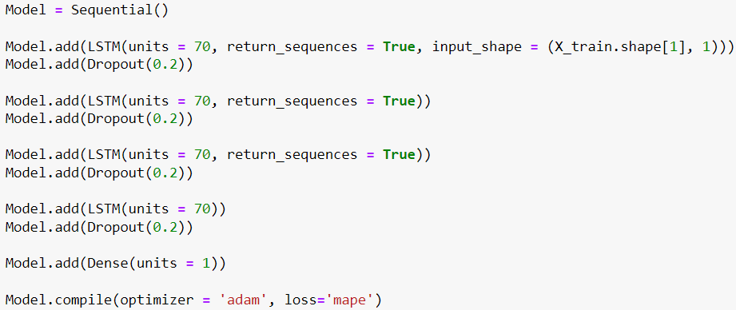
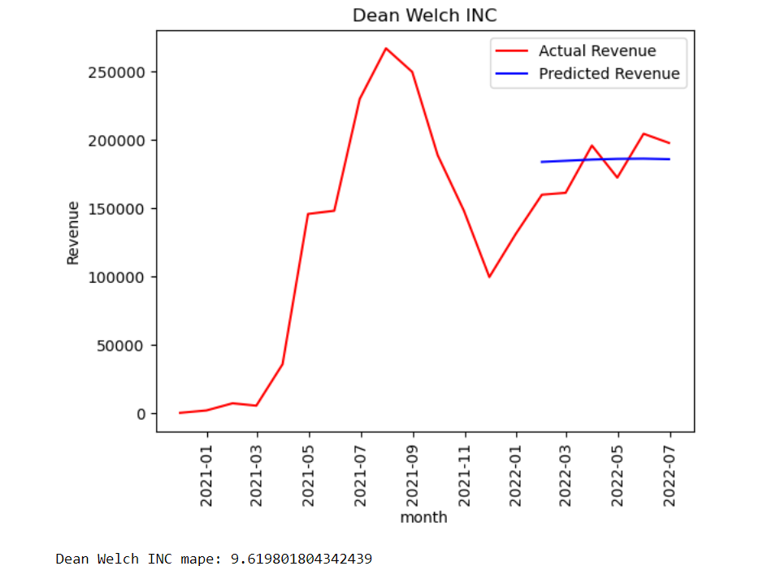
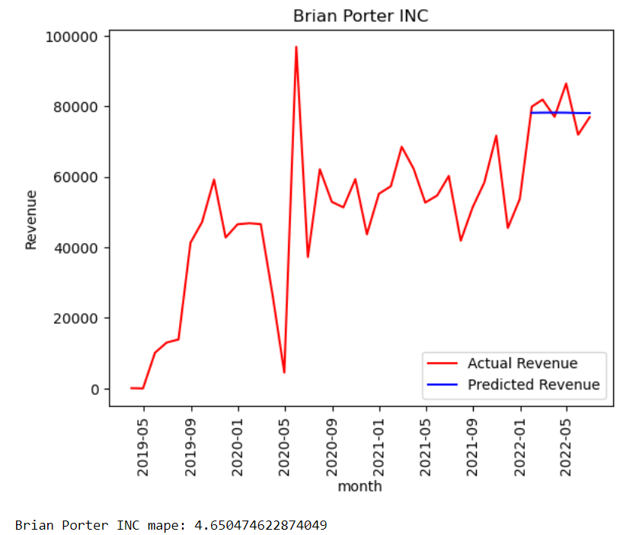
LSTM(Long short-term memory)
1) Use MinMaxScaler to scale monthly revenue to 0 to 1 for each client.
2) We have over 12 months data so at least we have 12 data points, meaning we have at least over 6 data points in our training data for each client after subtracting the testing data. We decide to use look back window as 6. So we look back 6 data points and create 6 features for each data point, as here t7 will have t1 to t6 as features.
3) After some trail and error, we find it using 4 hidden layers and each neural 70 units works fine as it will not make the computation heavy and the result is pretty good. Also, we drop off 20% input randomly. We use ‘adam’ method and use loss for MAPE for compile the model. We use epochs as 60 for iteration and batch_size as 34.
t1
t2
t3
t4
t5
t6
t7
t2
t3
t4
t5
t6
t7
t8

Slide 14
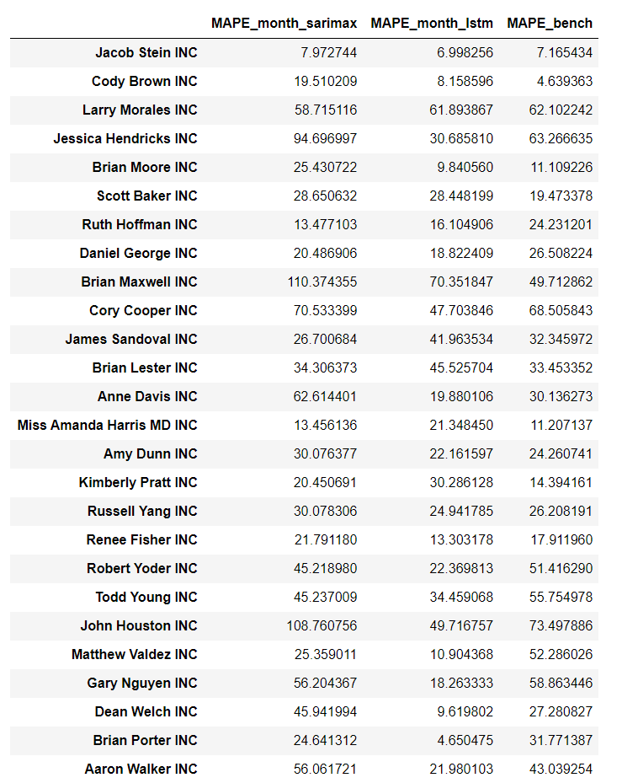
Model selection:
Compare model performance by using MAPE

Slide 15
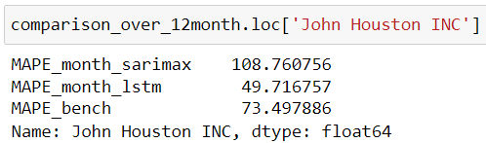
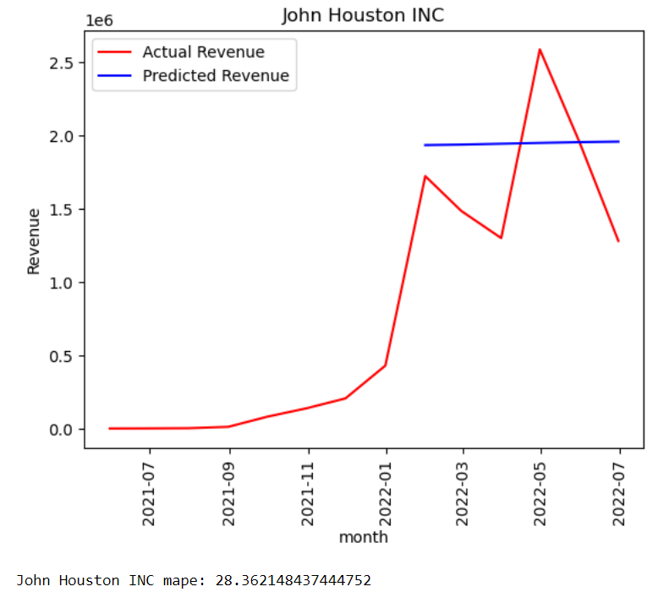
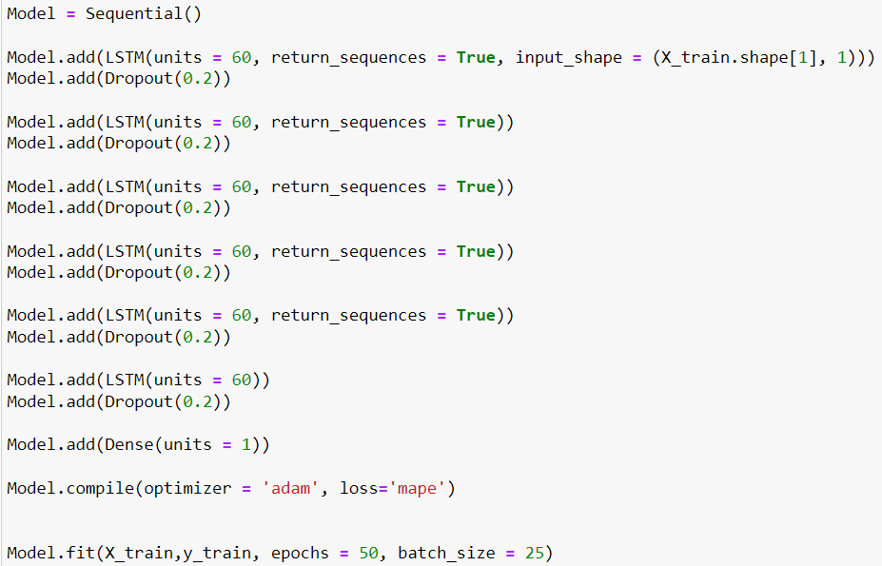
We see the models for ‘John Houston INC’ performs poorly. From previous studies, we know that ‘John Houston INC’ contribute almost 16% of total revenue for 2022. So we decide to create a LSTM model by using different parameter below for this client. We see that the performance is improving by a lot.

Slide 16
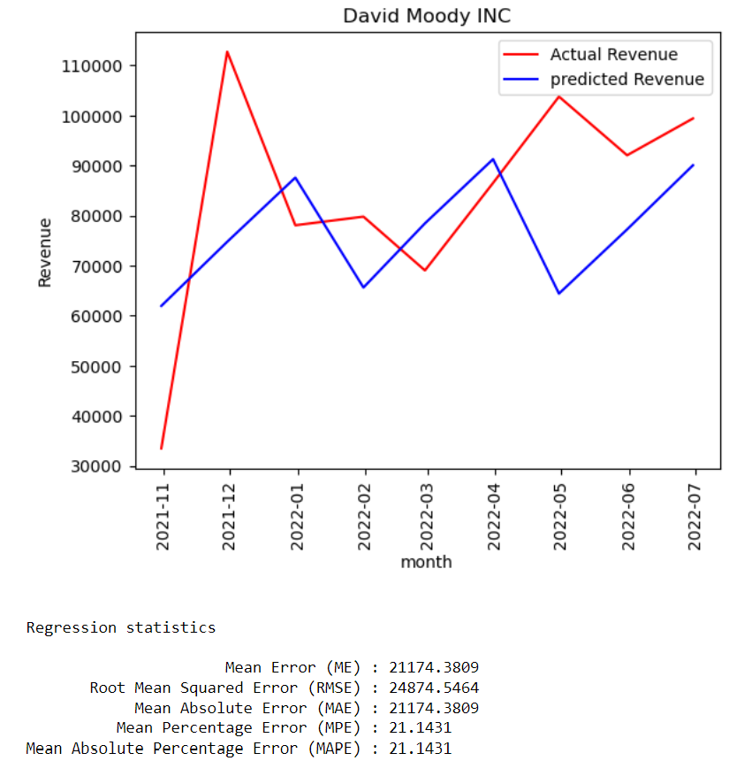
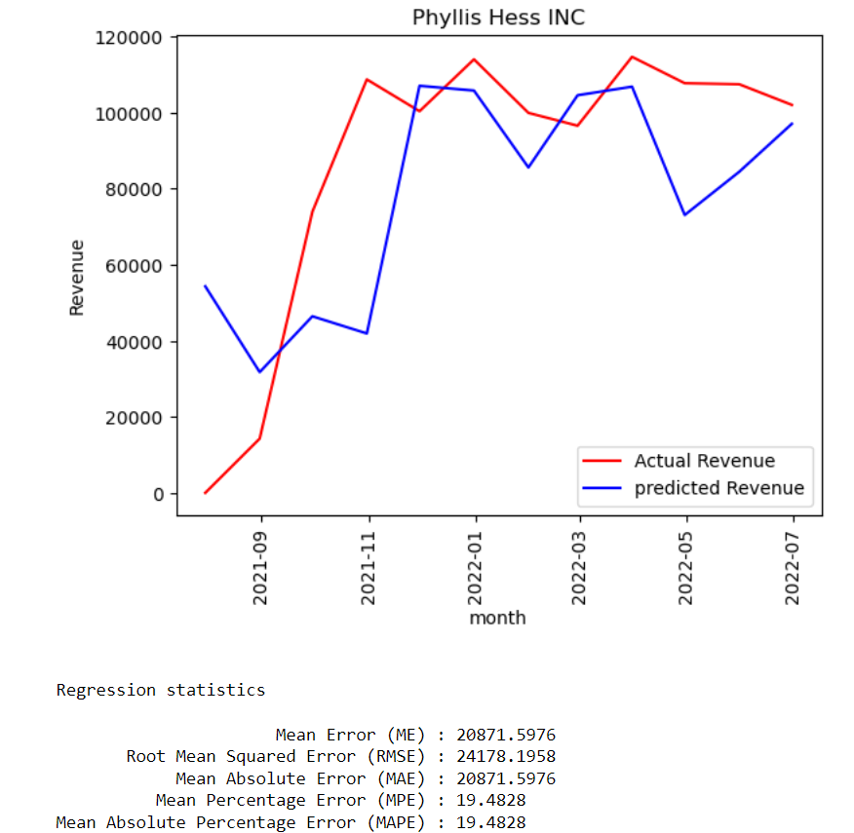
Clients between 6 months to 12 months(Validation: 3 months)
Benchmark model: naive model(using last month to predict)
SARIMA:
1) We create some feature based on the monthly data for exogenous variables. We drop shipping column as at the time of prediction we do not know the total shipping of the month.
2) We use auto_arima to get the best order and seasonal_order for SARIMAX model. Here we assume the seasonal parameter is 1(yearly).

Slide 17
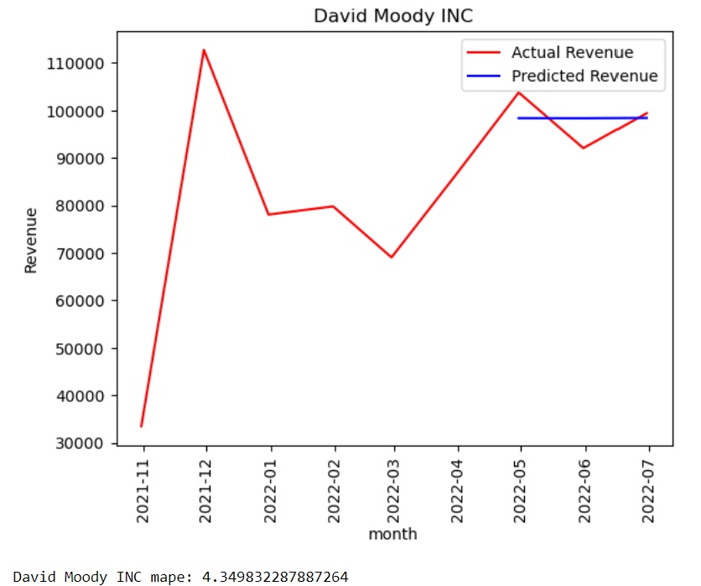
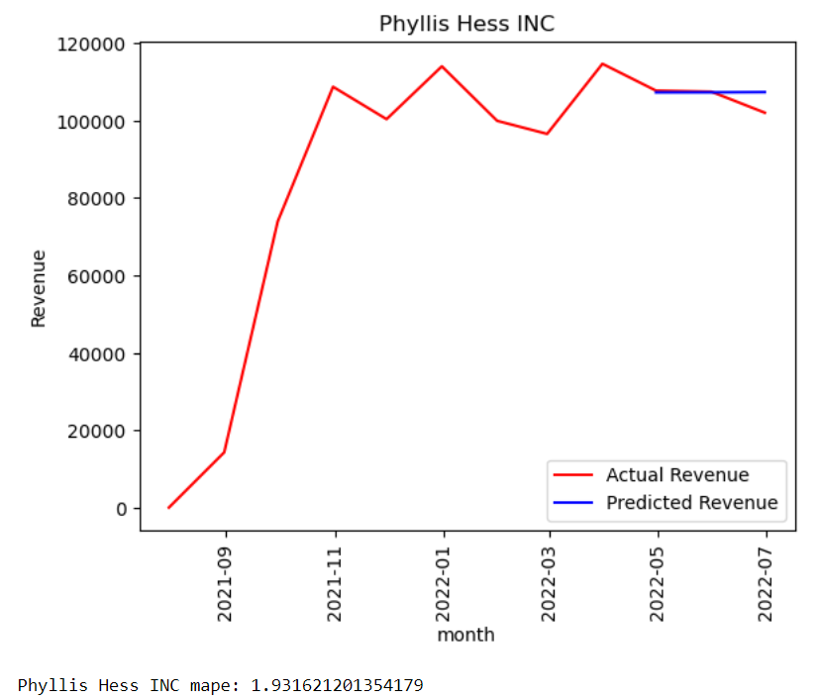
LSTM(Long short-term memory)
1) Use MinMaxScaler to scale monthly revenue to 0 to 1 for each client.
2) We have between 6 months and 12 months data so we have 6 to 12 data points, meaning that we have at least over 3 data points in our training data for each client after subtract the testing data. We decide to use look back window as 3. So we look back 3 data points and create 3 features for each data point, as here t4 will have t1 to t3 as features.
3) We keep the same parameter for client between 6 months and 12 months as for client over 12 months as later we will be using all available data points for forecasting.
t1
t2
t3
t4
t2
t3
t4
t5

Slide 18
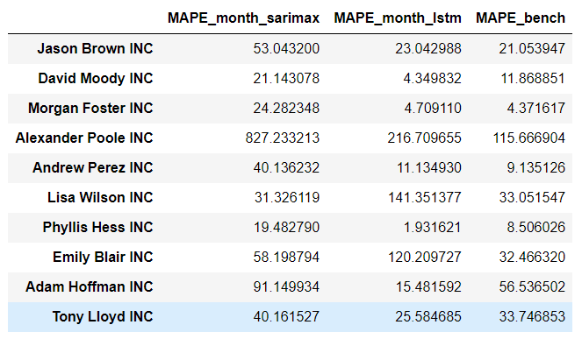
Model selection:
Compare model performance by using MAPE

Slide 19
Clients less than 6 months
Not enough data points, use naive model(use most recent month to predict)

Slide 20
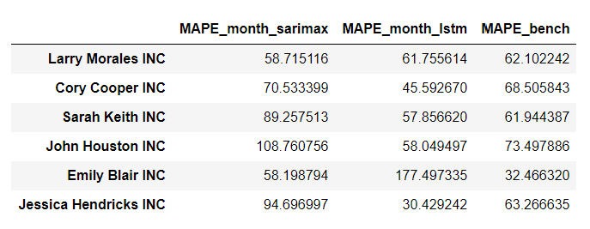
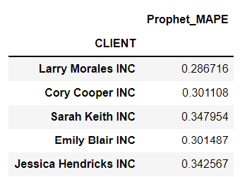
Forecasting
Use all data set available for forecasting
Based on previous modeling, we separate clients into different lists for different models(SARIMA, LSTM, NAIVE).
Special treatment: ‘John Houston INC’
However, after examination there are some clients that performed poorly with all three models. So for these clients, we are using prophet outcome for forecasting.

Slide 21
Create Dataframe for cluster analysis
Explaination:
index: Client name;
Column:
'sector': Client category
'to_now_day': first day in business to 2022-06-30
'firstToLast_day': first day in business to last day in business(usually should match to_now-day)
'con_zero_day': consecutive days that have no shippping
'con_shipping_day': consecutive days that have shippping
'max_day_shipping': max shipping in a day
'max_month_shipping': max shipping in a month
'ave_shipping_weekday': average shipping during weekday(including 0 shipping day)
'ave_shipping_weekend': average shipping at weekend(including 0 shipping day)
'abs_ave_shipping_weekday': average shipping during weekday(not including 0 shipping day)
'abs_ave_shipping_weekend': average shipping at weekend(not including 0 shipping day)
'max_day_revenue': max revenue in a day
'max_month_revenue': max revenue in a month
'ave_revenue_weekday': average revenue during weekday(including 0 shipping day)
'ave_revenue_weekend': average revenue at weekend(including 0 shipping day)
'abs_ave_revenue_weekday': average revenue during weekday(not including 0 shipping day)
'abs_ave_revenue_weekend': average revenue during weekday(not including 0 shipping day)

Slide 22
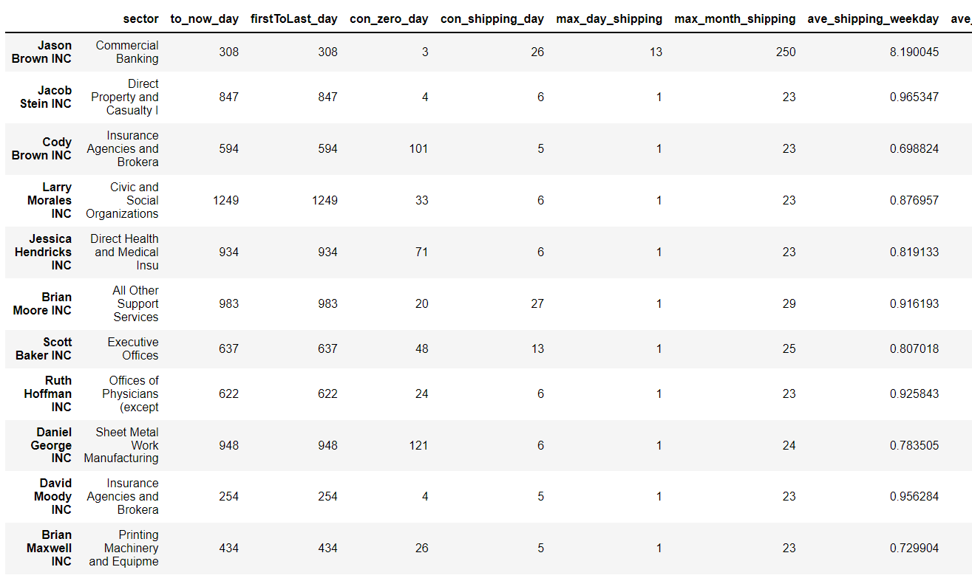

Slide 23
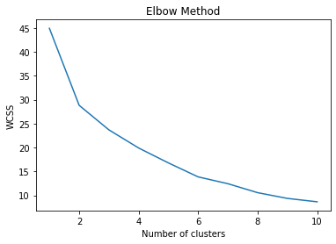
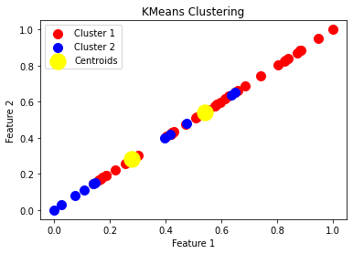
Clustering
Encode Categorical Variable
Mix-Max Scaling
Elbow Method
KMeans Clustering

Slide 24
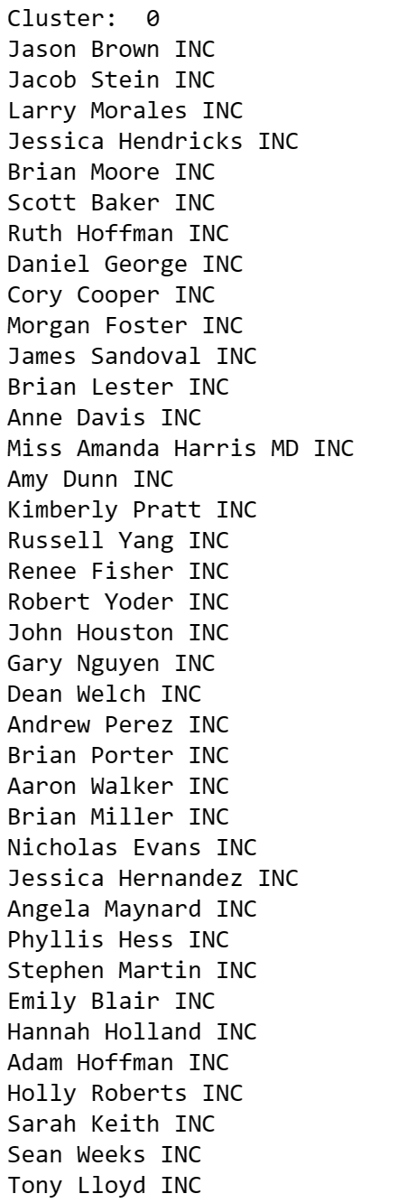
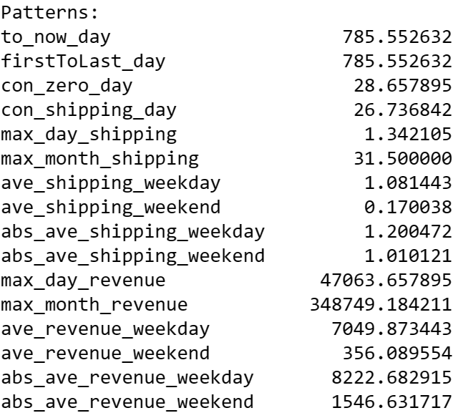
Two Clusters: Cluster 0
Longer time period between first and last shipment
More consistent shipping patterns with fewer consecutive days without shipping
Higher maximum revenue per day and month, and higher average revenue on weekdays
More revenue generated on weekends compared to Cluster 1

Slide 25
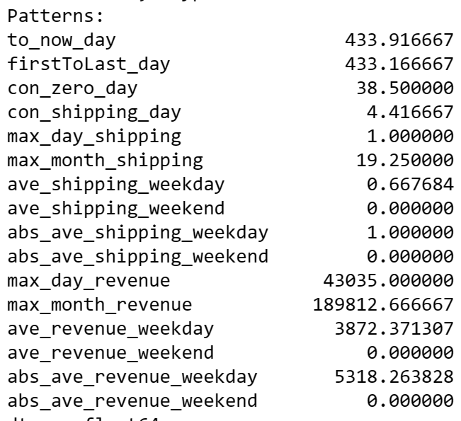
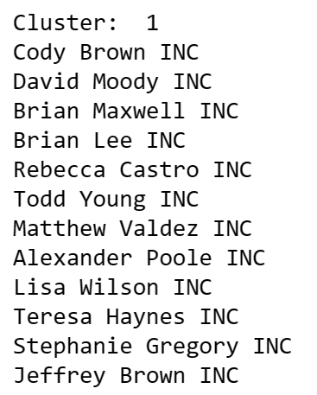
Two Clusters: Cluster 1
Shorter time period between first and last shipment
More variable shipping patterns with more consecutive days without shipping
Lower maximum revenue per day and month, and lower average revenue on weekdays
No revenue generated on weekends

Slide 26
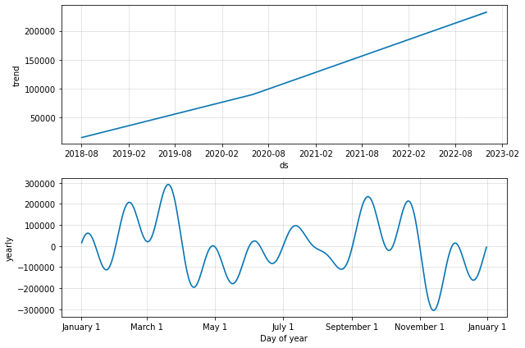
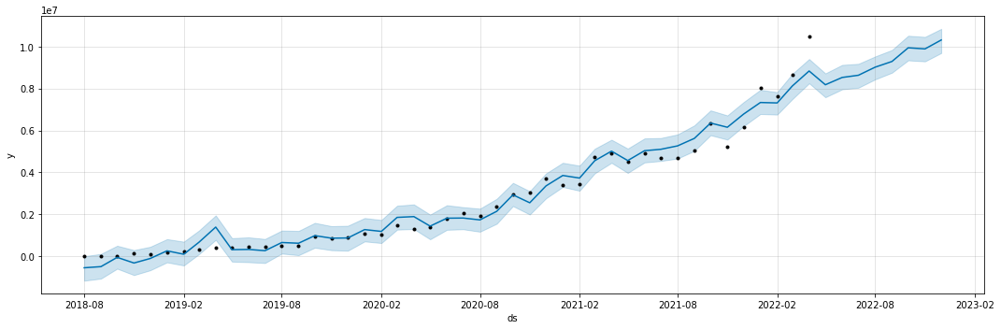
PROPHET
MODEL: Cluster 0
Prophet model achieved a low MAPE of 0.034 for Cluster 0, indicating a good fit for the data
Predictions aligned well with actual values and confidence intervals were tight
Cluster 0 clients have a strong seasonal pattern in revenue, with a peak in the first quarter
Revenue had a steady growth trend, suggesting potential business expansion opportunities
Understanding these patterns can help Pitney Bowes to better forecast revenue and plan resources accordingly

Slide 27


PROPHET
MODEL:Cluster 1
Prophet MAPE for Cluster 1: 0.485, indicating a lower accuracy compared to Cluster 0
Revenue trend shows irregularities and fluctuations, with more unpredictable shipping throughput
Yearly graph indicates a more dramatic drop in revenue in the second and fourth quarters, suggesting greater variability in shipping needs for Cluster 1 clients
Recommendations include providing more consistent and reliable services for Cluster 0 clients, offering more flexible solutions for Cluster 1 clients, and improving forecasting and planning processes based on insights from the analysis

Slide 28
Thank you!

Slide 29




Slide 30

The correlation matrix shows a strong positive correlation between ave_shipping_weekend and con_shipping_day (0.81), as well as between ave_revenue_weekend and con_shipping_day (0.81).
This indicates that clients who have longer periods of non-zero shipping days (con_shipping_day) tend to have higher average number of shipments and revenue generated on weekends (ave_shipping_weekend and ave_revenue_weekend).
Notes:
The correlation matrix shows a strong positive correlation between ave_shipping_weekend and con_shipping_day (0.81), as well as between ave_revenue_weekend and con_shipping_day (0.81). This indicates that clients who have longer periods of non-zero shipping days (con_shipping_day) tend to have higher average number of shipments and revenue generated on weekends (ave_shipping_weekend and ave_revenue_weekend).
Clients with high con_shipping_day, ave_shipping_weekend and ave_revenue_weekend Recommendation: Pitney Bowes can offer targeted promotions to these clients to encourage increased weekend shipping and revenue generation. Additionally, the company could consider offering weekend-specific services or support to further assist these clients with their weekend shipping needs.

Slide 31


Business Recommendation:
For Cluster o: As clients in this cluster have a longer history of using our services and consistent shipping throughput, we can focus on building stronger relationships with them through personalized and value-added services to increase their loyalty.
For Cluster 1: As clients in this cluster have a shorter history of using our services and varying shipping throughput, we can focus on providing more personalized and flexible solutions to meet their changing needs and increase their satisfaction.
Notes:
Clients in cluster 0 have a higher average value of "to_now_day" which means that they have been using our services for a longer period of time. The histogram shows that most of the clients in this cluster have been using our services for 200 to 800 days. The box plot shows that the interquartile range (IQR) of "firstToLast_day" is between 600 to 1000 days, indicating that clients in this cluster tend to have consistent shipping throughput over time.
Recommendation: As clients in this cluster have a longer history of using our services and consistent shipping throughput, we can focus on building stronger relationships with them through personalized and value-added services to increase their loyalty.

Slide 32




Business Recommendation:
1. Offer weekend support services to clients in cluster 0 to increase their satisfaction and loyalty.
2. Offer personalized and value-added services to clients in cluster 0 to increase their loyalty and retention.
3. We can provide more flexible and scalable solutions to clients in cluster 0 to meet their higher shipping demands.
4. Provide more personalized and premium services to clients in cluster 0 to increase their revenue and satisfaction.
Notes:
Based on the pie charts generated for each variable by cluster, we can make the following observations and recommendations:
1st pie chart:
The average number of shipments per weekend day is 100% cluster 1, indicating that clients in this cluster have a lower tendency to ship on weekends.
Recommendation: We can offer weekend support services to clients in this cluster to increase their satisfaction and loyalty.
2nd pie chart:
The number of days from the first transaction until the current date is 85.1% cluster 0 and 14.9% cluster 1, indicating that clients in cluster 0 have been using our services for a longer period of time.
Recommendation: We can offer personalized and value-added services to clients in cluster 0 to increase their loyalty and retention.
3rd pie chart:
The maximum number of shipments in a single day is 81% cluster 0 and 19.0% cluster 1, indicating that clients in cluster 0 tend to have higher shipping throughput than those in cluster 1.
Recommendation: We can provide more flexible and scalable solutions to clients in cluster 0 to meet their higher shipping demands.
4th pie chart:
The highest revenue generated by the client in a single day is 77.6% cluster 0 and 22.4% cluster 1, indicating that clients in cluster 0 tend to generate more revenue than those in cluster 1.
Recommendation: We can provide more personalized and premium services to clients in cluster 0 to increase their revenue and satisfaction.

Slide 33


Business Recommendations:
For cluster 0, we can focus on increasing the revenue further by providing more customized solutions to meet their needs.
For cluster 1, we can investigate the causes of the volatility in their shipping volume and work on stabilizing it.
Notes:
we can see that there are two distinct clusters of clients with different patterns of revenue and shipping behavior.
Cluster 0 shows a steady increase in revenue over time and reaches its peak in March 2022 with over 250,000 in revenue. This cluster also shows a steady increase in shipping volume over time.
Cluster 1, on the other hand, has a lower average revenue than cluster 0 and shows some seasonality with peaks in revenue in March 2021 and June 2022 with revenue around 150,000. This cluster also shows a more volatile shipping volume behavior, with a dramatic increase in shipping volume between March and July 2020, followed by a drop and then some recovery.

